Slide 1
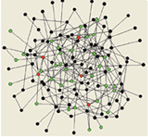
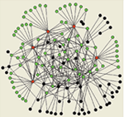
Network motifs
Szymon Stoma

Slide 2
What is a Network?
A map of interactions or relationships
A collection of nodes and links (edges)

Slide 3
What is a Network?
A map of interactions or relationships
A collection of nodes and links (edges)

Slide 4
Why Networks?
Focus on the organization of the system (rather than on its components)
Simple representation
Visualization of complex systems
Networks as tools
Underlying diffusion model (e.g. evolution on networks)
The structure and topology of the system affect (determine) its function

Slide 5
Graphs
Graph Theory
Definition of a graph: G=(V,E)
V is the set of nodes/vertices (elements)
|V|=N
E is the set of edges (relations)
One of the most well studied objects in CS
Subgraph finding (e.g., clique, spanning tree) and alignment
Graph coloring and graph covering
Route finding (Hamiltonian path, traveling salesman, etc.)
Many problems are proven to be NP-complete

Slide 6
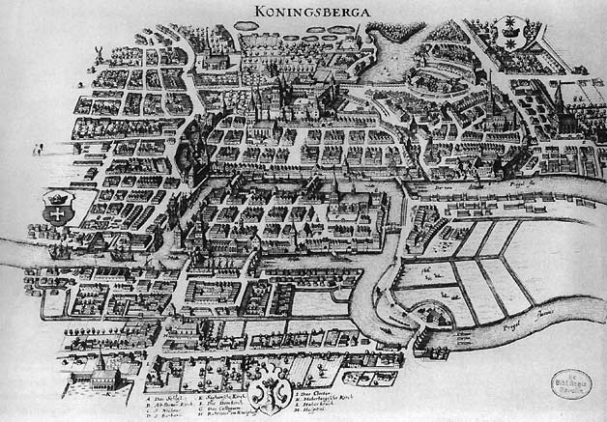
The Seven Bridges of Königsberg
Published by Leonhard Euler, 1736
Considered the first paper in graph theory

Slide 7
Types of Graphs/Networks
Directed/undirected
Weighted/non-weighted
Directed Acyclic Graphs (DAG) / Trees
Bipartite Graphs
Hypergraphs
Notes:
3 important factor: directionality, Weight, Cycles

Slide 8
Computational Representation of Networks
A
B
C
D
List/set of edges: (ordered) pairs of nodes { (A,C) , (C,B) , (D,B) , (D,C) }
Connectivity Matrix
Object Oriented
 | A | B | C | D
A | 0 | 0 | 1 | 0
B | 0 | 0 | 0 | 0
C | 0 | 1 | 0 | 0
D | 0 | 1 | 1 | 0
Name:D ngr:
Name:C ngr:
Name:A ngr:
p1
p2
p1
Name:B ngr:
p1
Which is the most useful representation?

Slide 9
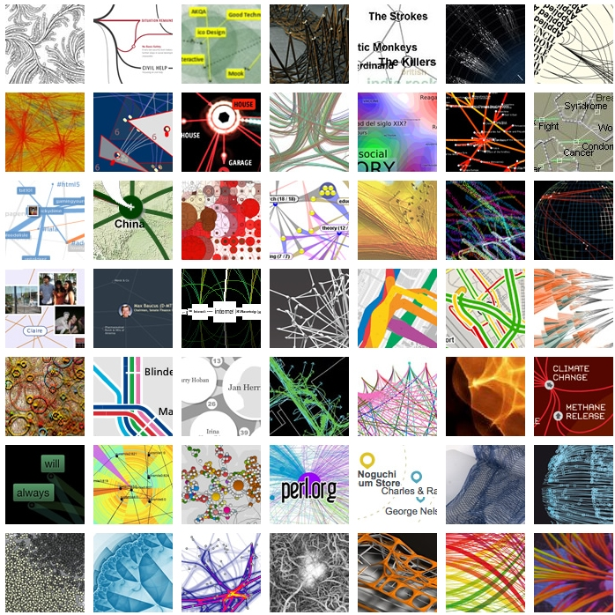
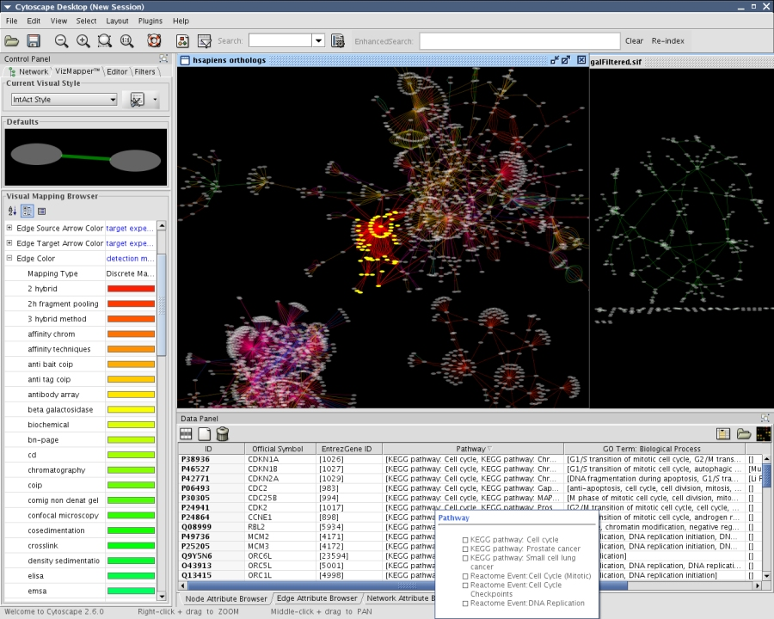
Network Visualization
VisualComplexity.com
Art? Science?
Cytoscape

Slide 10
Networks in Biology
Molecular networks:
Protein-Protein Interaction (PPI) networks
Metabolic Networks
Regulatory Network
Synthetic lethality Network
Gene Interaction Network
More …

Slide 11
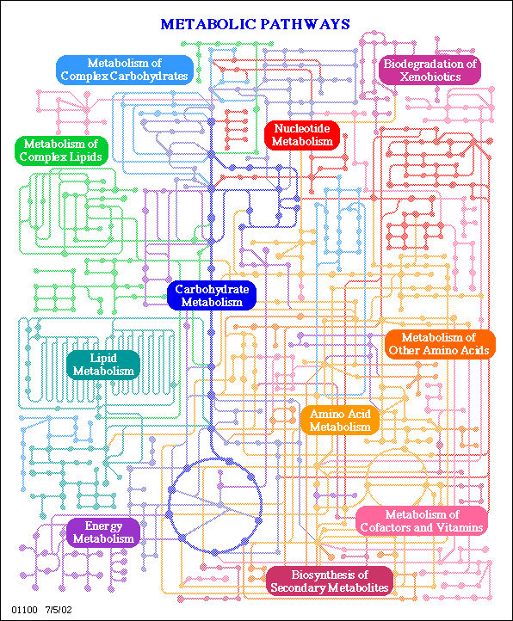
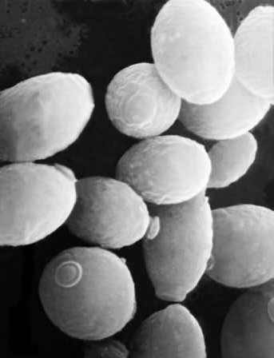
Reflect the set of biochemical reactions in a cell
Nodes: metabolites
Edges: biochemical reactions
Additional representations!
Derived through:
Knowledge of biochemistry
Metabolic flux measurements
S. Cerevisiae
1062 metabolites
1149 reactions

Slide 12
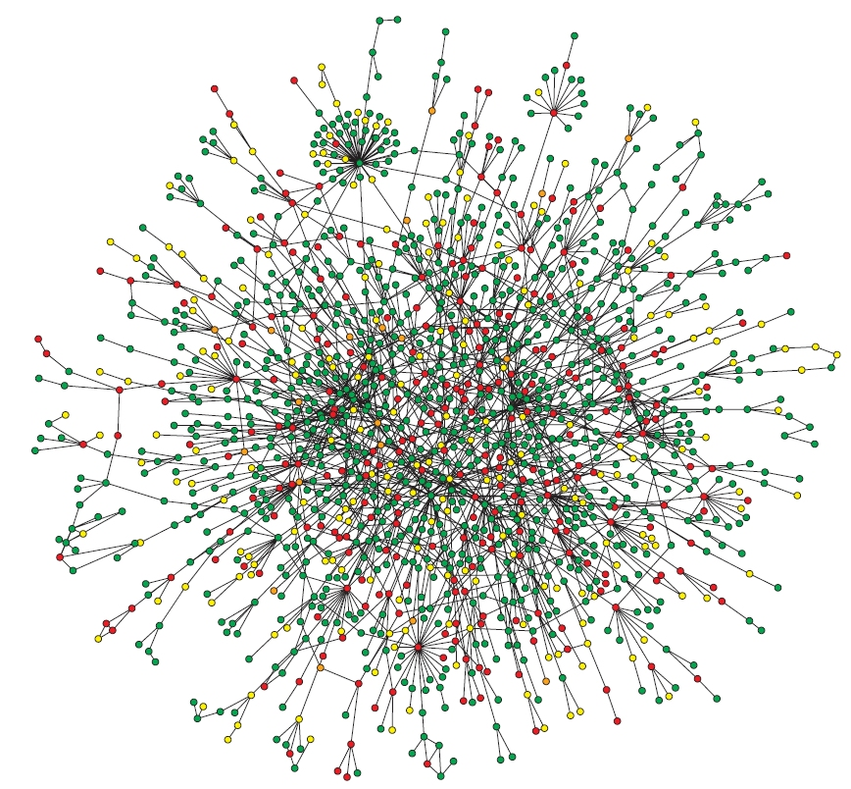
Protein-Protein Interaction (PPI) Networks
Reflect the cell’s molecular interactions and signaling pathways (interactome)
Nodes: proteins
Edges: interactions(?)
High-throughput experiments:
Protein Complex-IP (Co-IP)
Yeast two-hybrid
S. Cerevisiae
4389 proteins
14319 interactions
Notes:
Protein complex immunoprecipitation (Co-IP)

Slide 13
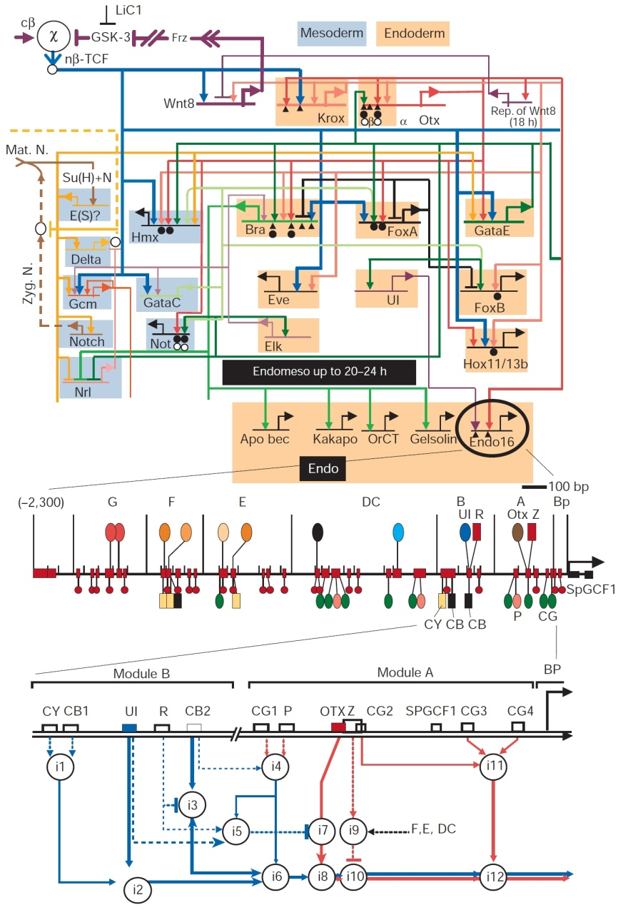
Transcriptional Regulatory Network
Reflect the cell’s genetic regulatory circuitry
Nodes: transcription factors (TFs) and genes;
Edges (directed): from TF to the genes it regulates
Derived through:
Chromatin IP
Microarrays

Slide 14
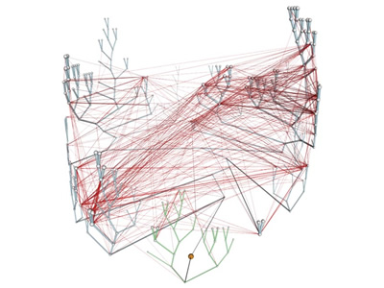
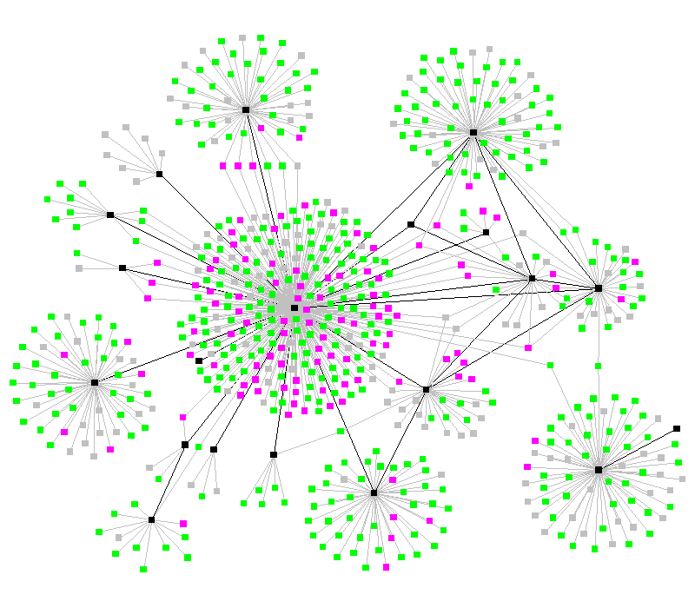
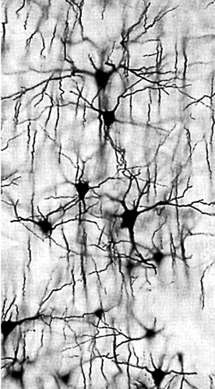
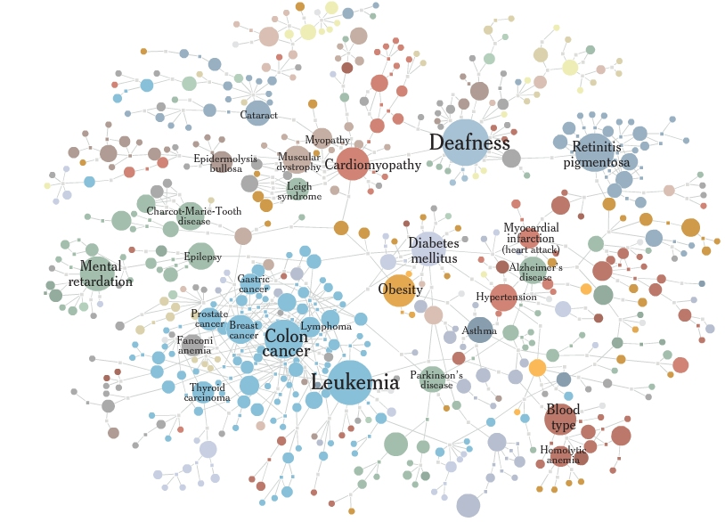
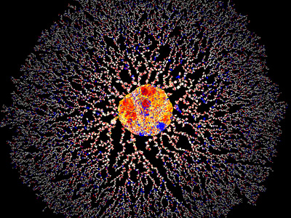
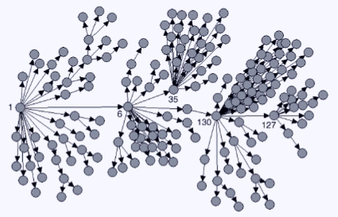
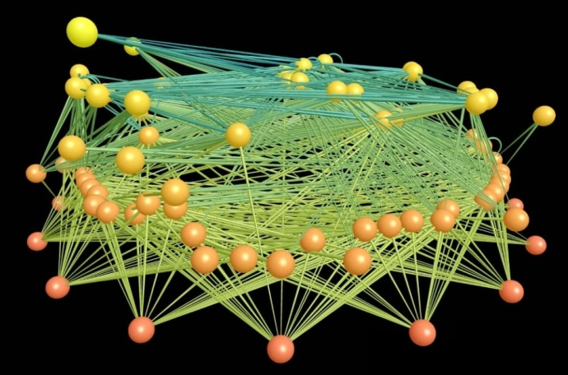
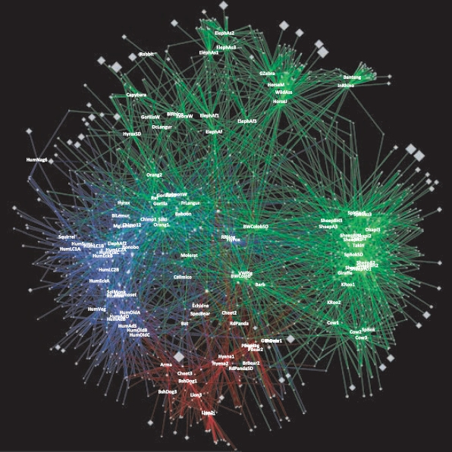
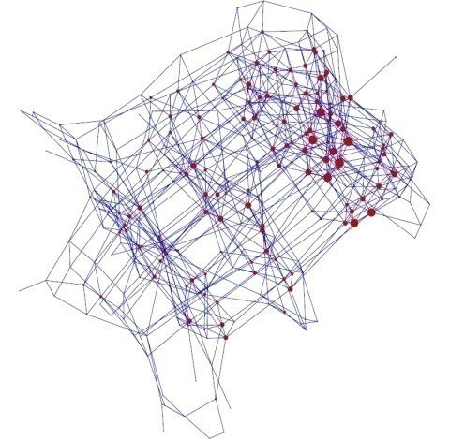
Other Networks in Biology/Medicine

Slide 15
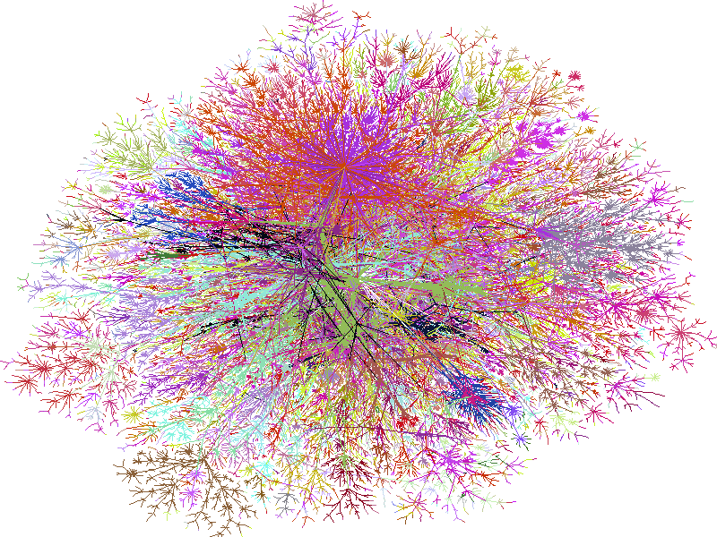
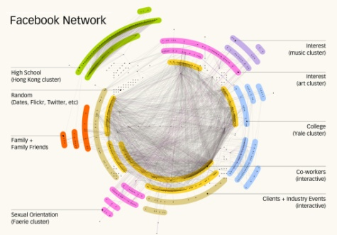
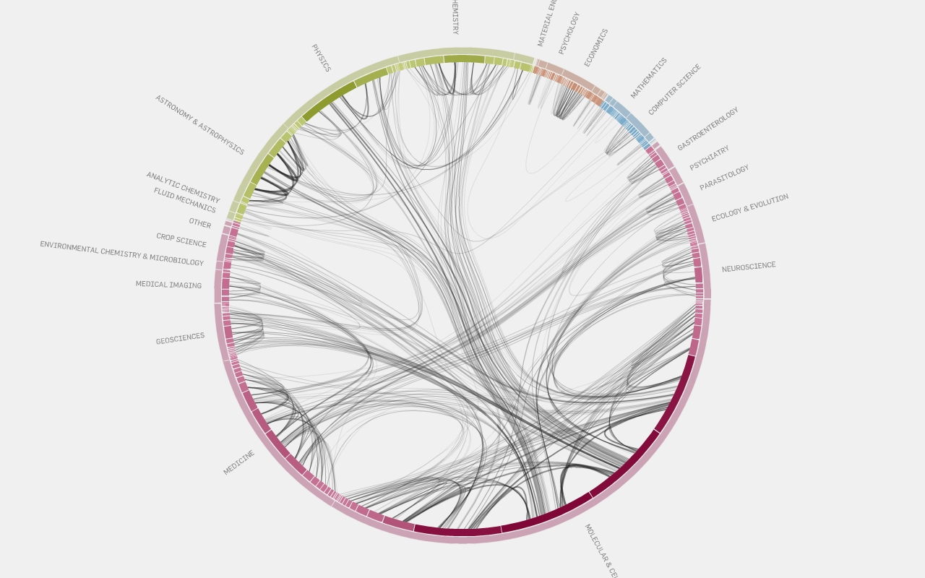
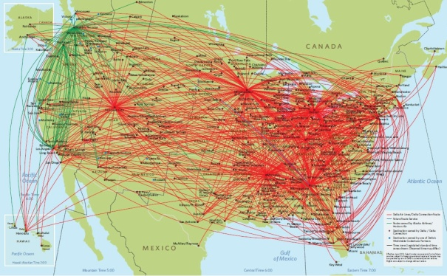
Non-Biological Networks
Computer related networks:
WWW; Internet backbone
Communication and IP
Social networks:
Friendship (facebook; clubs)
Citations / information flow
Co-authorships (papers); Co-occurrence (movies; Jazz)
Transportation:
Highway system; Airline routes
Electronic/Logic circuits
Many more…

Slide 16
Node Degree / Rank
Degree = Number of neighbors
Local characterization!
Node degree in PPI networks correlates with:
Gene essentiality
Conservation rate
Likelihood to cause human disease

Slide 17
Degree Distribution
Degree distribution P(k): probability that a node has degree k
For directed graphs, two distributions:
In-degree
out-degree
Average degree:
Number of edges: Nd/2

Slide 18
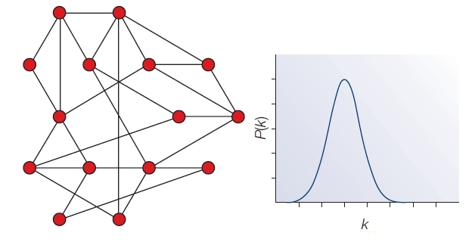
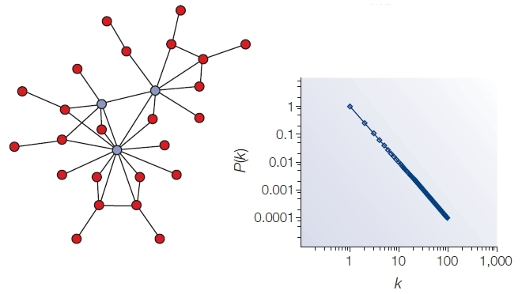
Common Distributions
Poisson:
Exponential:
Power-law:
Notes:
Why does power-law distribution matter?

Slide 19
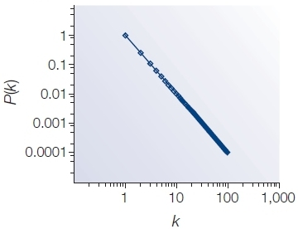
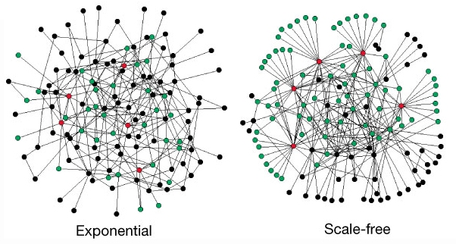
The Power-Law Distribution
Fat or heavy tail!
Leads to a “scale-free” network
Characterized by a small number of highly connected nodes, known as hubs
Hubs are crucial:
Affect error and attack tolerance of complex networks (Albert et al. Nature, 2000)

Slide 20
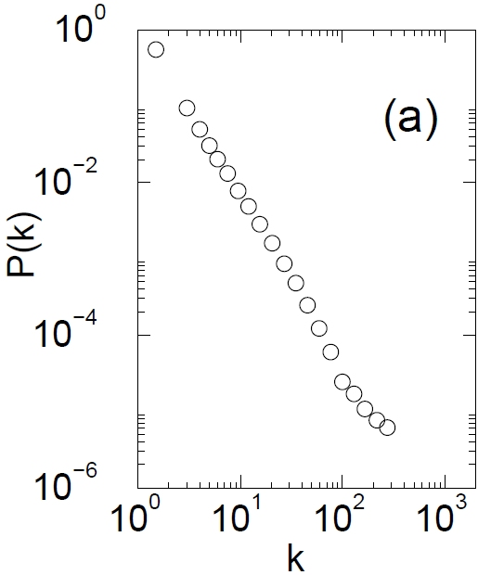
The Internet
Nodes – 150,000 routers
Edges – physical links
P(k) ~ k^{-2.3}
Govindan and Tangmunarunkit, 2000

Slide 21
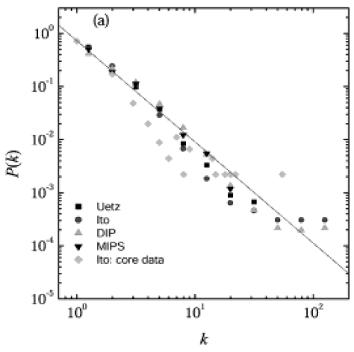
Protein Interaction Networks
Nodes – Proteins
Edges – Interactions (yeast)
P(k) ~ k^{-2.5}
Yook et al, Proteomics, 2004

Slide 22
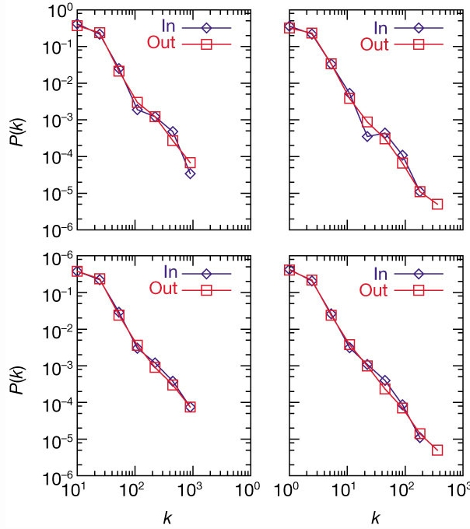
Metabolic Networks
Nodes – Metabolites
Edges – Reactions
P(k) ~ k^{-2.2±2}
Metabolic networks across all kingdoms of life are scale-free
A.Fulgidus (archae)
E. Coli (bacterium)
C.Elegans (eukaryote)
Averaged (43 organisms)
Jeong et al., Nature, 2000

Slide 23
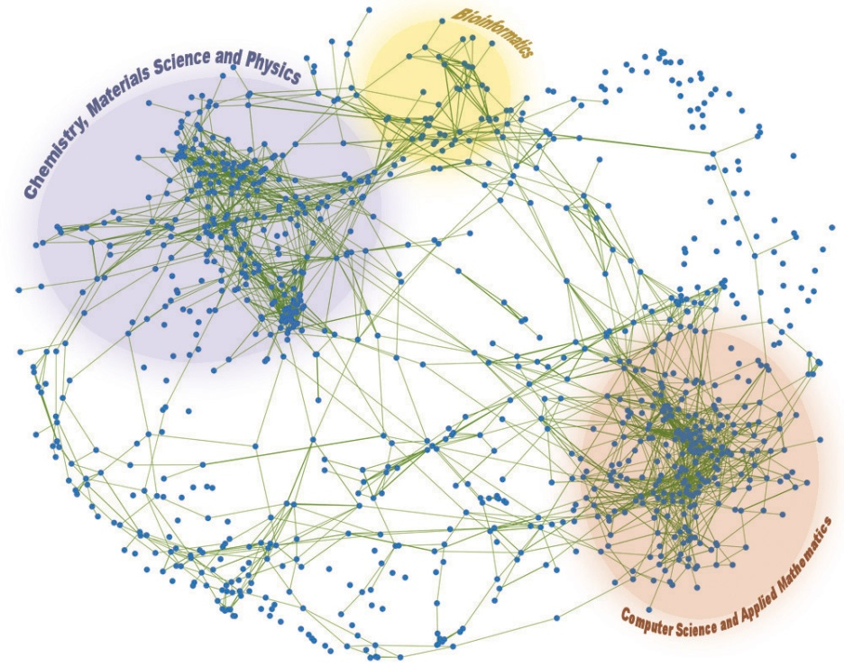
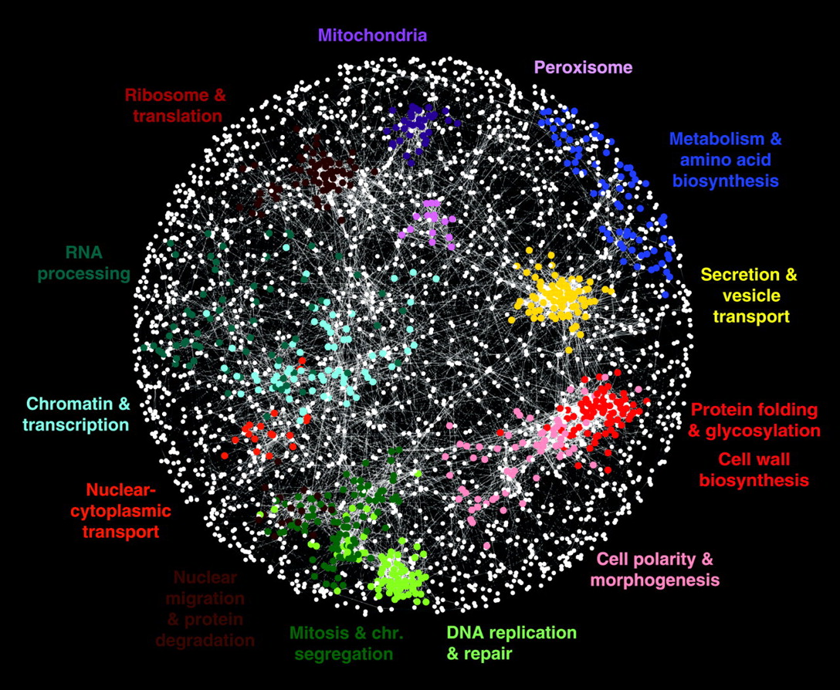
Network Clustering
Costanzo et al., Nature, 2010

Slide 24
Clustering Coefficient (Watts & Strogatz)
Characterizes tendency of nodes to cluster
“triangles density”
“How often do my (facebook) friends know each other
(if d_{i} = 0 or 1 then C_{i} is defined to be 0)
Notes:
How many of your neighbors know one another (FACEBOOK)

Slide 25
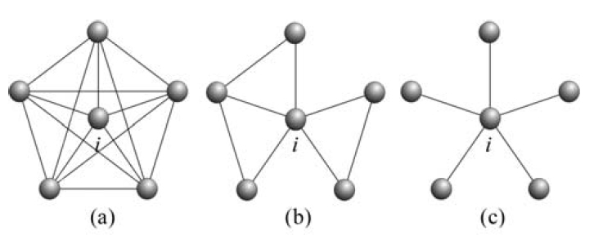
Clustering Coefficient: Example
Lies in [0,1]
For cliques: C=1
For triangle-free graphs: C=0
C_{i}=10/10=1
C_{i}=3/10=0.3
C_{i}=0/10=0

Slide 26
Network Motifs
What is “Network Motif” ?
Network Motifs are defined as patterns of
interconnections that occur in many
different parts of a network at frequencies
much higher than those found in
randomized networks.
Why do we need them?
To help us understand how biological networks work.
Exact forecasting of operation and reaction in the network under given situations.

Slide 27
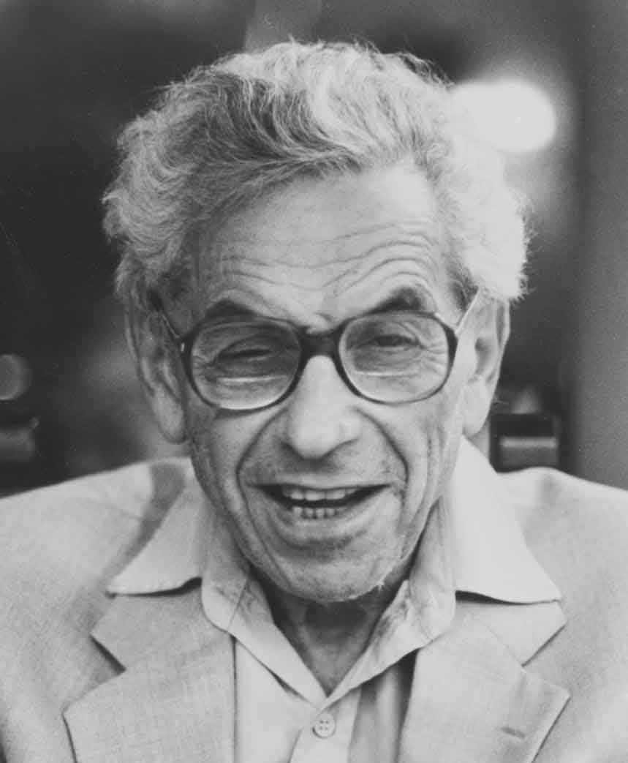
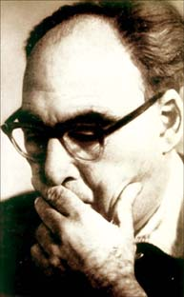
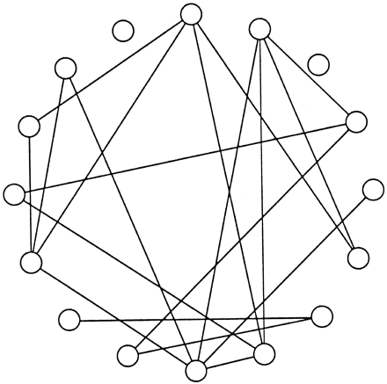
Random Graphs (Erdös/Rényi)
N nodes
Every pair of nodes is connected with probability p
Mean degree: d = (N-1)p ~ Np

Slide 28
Generation of Randomized Networks
Algorithm B (Generative):
Record marginal weights of original network
Start with an empty connectivity matrix M
Choose a row n & a column m according to marginal weights
If M_{nm} = 0, set M_{nm} = 1; Update marginal weights
Repeat until all marginal weights are 0
If no solution is found, start from scratch
 | A | B | C | D
A | 0 | 0 | 1 | 0 | 1
B | 0 | 0 | 0 | 0 | 0
C | 0 | 1 | 0 | 0 | 2
D | 0 | 1 | 1 | 0 | 2
 | 0 | 2 | 2 | 0
 | A | B | C | D
A | 0 | 0 | 0 | 0 | 1
B | 0 | 0 | 0 | 0 | 0
C | 0 | 0 | 0 | 0 | 2
D | 0 | 0 | 0 | 0 | 2
 | 0 | 2 | 2 | 0
 | A | B | C | D
A | 0 | 0 | 0 | 0 | 1
B | 0 | 0 | 0 | 0 | 0
C | 0 | 0 | 0 | 0 | 2
D | 0 | 0 | 0 | 0 | 2
 | 0 | 2 | 2 | 0
 | A | B | C | D
A | 0 | 0 | 0 | 0 | 1
B | 0 | 0 | 0 | 0 | 0
C | 0 | 1 | 0 | 0 | 1
D | 0 | 0 | 0 | 0 | 2
 | 0 | 1 | 2 | 0
A
B
C
D
Notes:
The two algorithms gave identical results for the sub graph statistics.

Slide 29
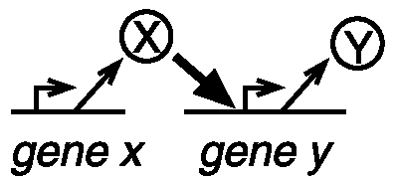
Transcriptional network of E.coli
Nodes are operons
Directed edge between two nodes, if one operon encodes a transcription factor, which regulates the other.
424 nodes and 519 edges
[Shen-Orr 2002, Thieffry 1998]

Slide 30
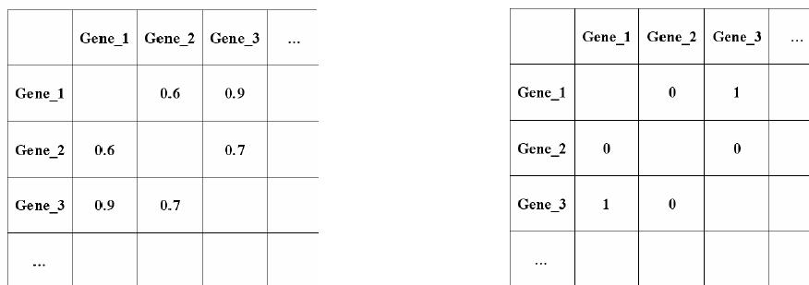
Co-expression Network
The genes are vertices (nodes).
An unweighted, and undirected edge (connection) is put between two genes if they are co-expressed with correlation higher than a specified threshold.
Correlation Matrix
Adjacency Matrix
Cutoff : 0.8

Slide 31
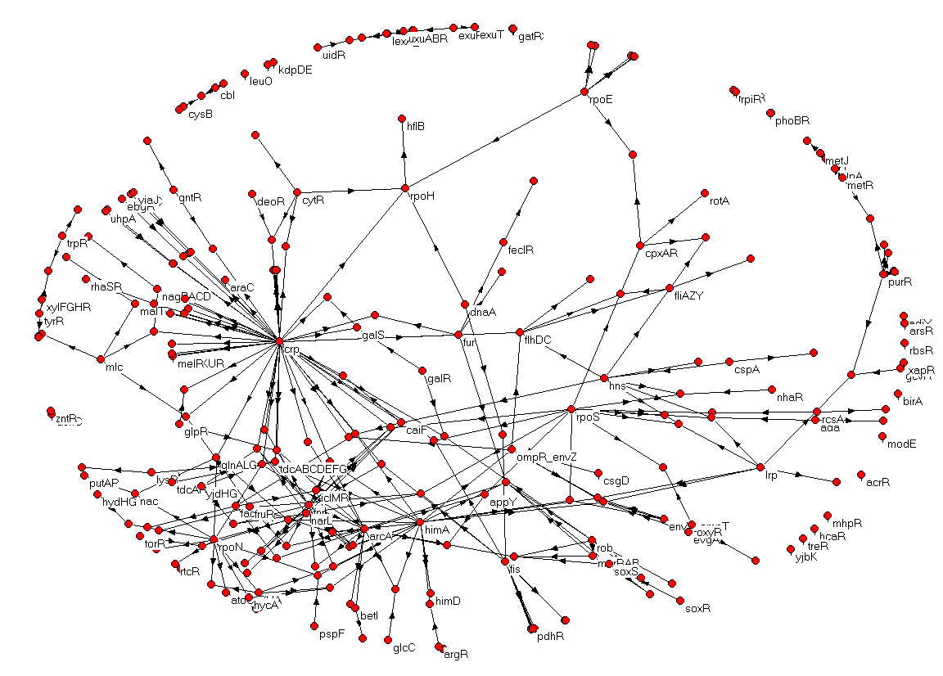
Network of transcriptional interactions in E. coli
N=420;E=520;Ns=40
Thieffry, Collado-Vides, 1998
Shen-Orr, Alon, Nature Genetics 2002

Slide 32
Finding motifs in the Network
1. Generate randomized networks
2a. Scan for all n-node subgraphs in the real network
2b. Record number of appearances of each subgraph (consider isomorphic architectures)
3a. Scan for all n-node sub graphs in rand’ networks
3b. Record number of appearances of each sub graph
4. Compare each subgraph’s data and choose motifs

Slide 33
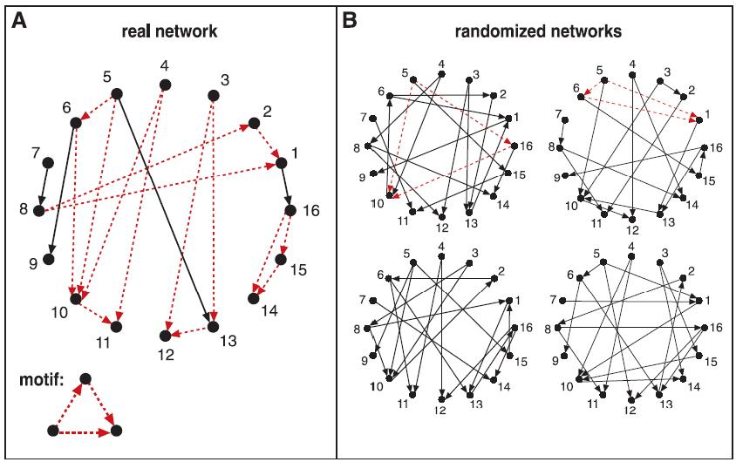
Schematic View of Network Motif Detection

Slide 34
Examples for motifs
FeedForward Loop
Found in neural networks.
It seems to be Used for neutralize
“Biological Noise”.
X Y Z
Single-Input Module
X
Implemented in gene control networks
a
b
c
d

Slide 35
Auto-regulation network motif

Slide 36
Auto-regulation network motif
X
X
A

Slide 37
Is an autoregulation a network motif?

Slide 38
Modeling negative auto-regulatory network motifs
Suppose a TF X negatively regulates its own expression. The dynamics of X can be given by
X
X_{max}
X_{max}/2
Saturation level
T_{1/2}
t
Response time

Slide 39
Comparison with simple regulation
In comparison, we consider the simple regulation
X
Saturation level
X_{max}
X_{max}/2
Response time
T_{1/2}
t

Slide 40
Comparison with simple regulation
For meaningful comparison, assume that the parameters are as similar as possible.

Slide 41
Comparison with simple regulation
For meaningful comparison, assume that the parameters are as similar as possible.
X
X_{max}
n.a.r.
simple.
Negative auto-regulatory motif speeds up response time.
X_{max}/2
p.a.r.
T_{1/2}
t

Slide 42
Thanks

